Slide 1
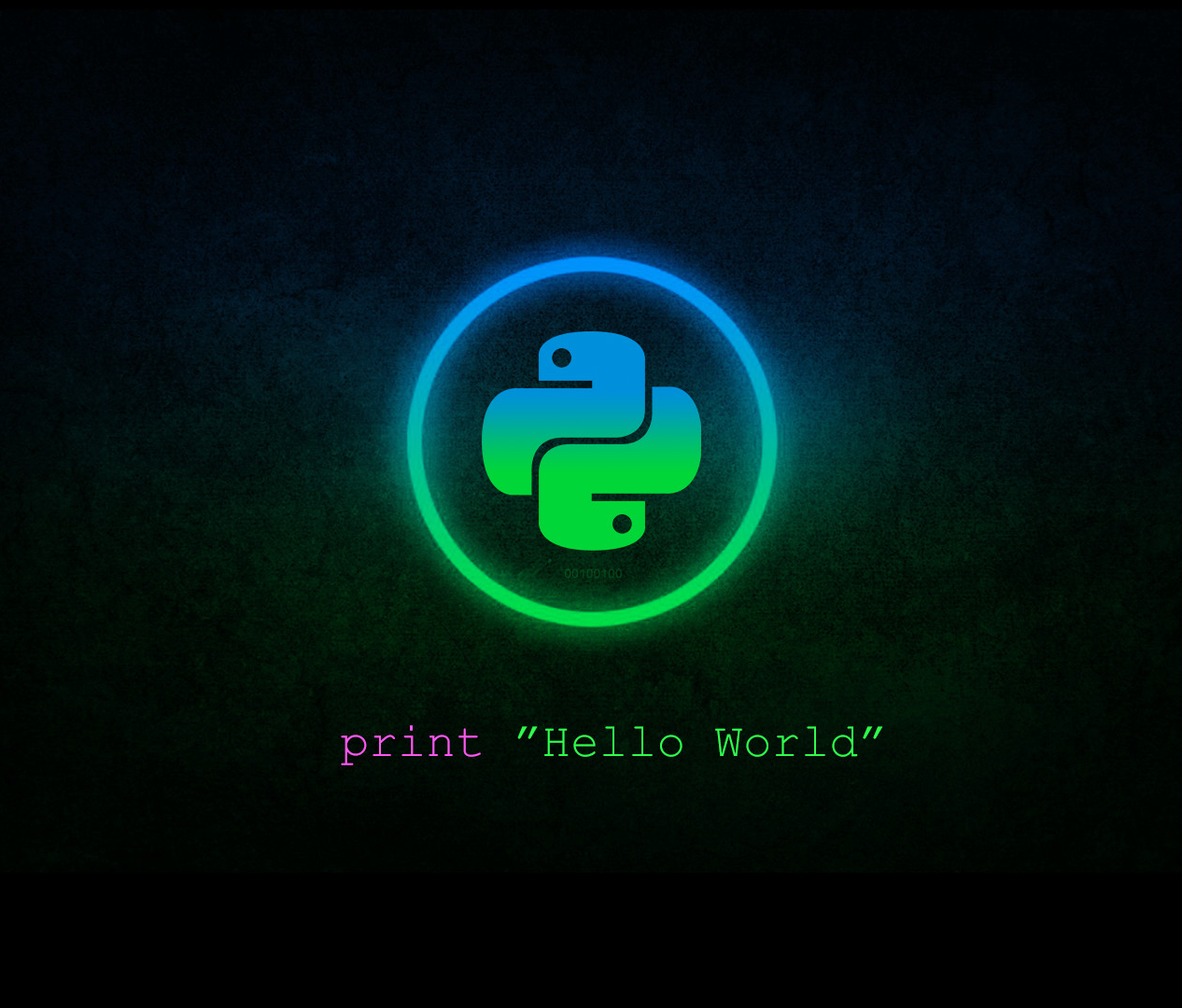



Python Basics part ll
Class
viii
Lab 18
Supported by
Powered By

Slide 2
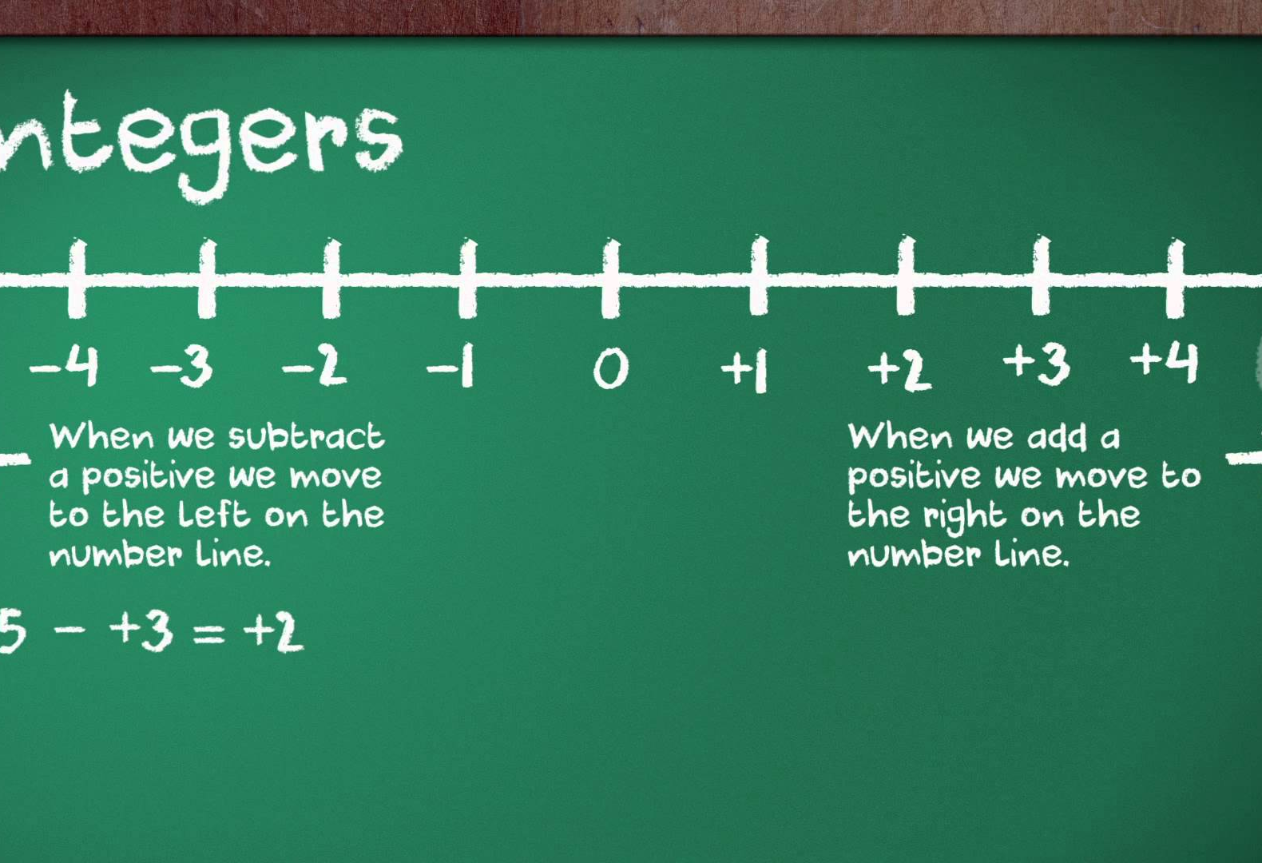
Integers
All positive and negative numbers. Zero is also an Integer
Supported by
Powered By

Slide 3
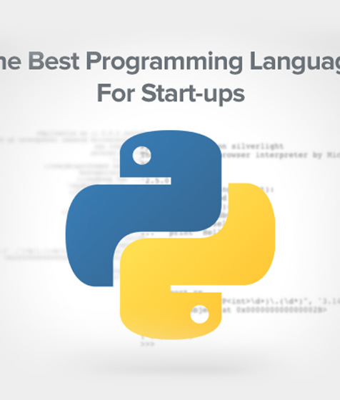
Floating point
The best programming language for start ups
Digit including point
-1.2, -1.50, 1.1, 1.2, 2.5
Note that the value 42 is an integer but 42.0 is a floating point
Supported by
Powered By

Slide 4
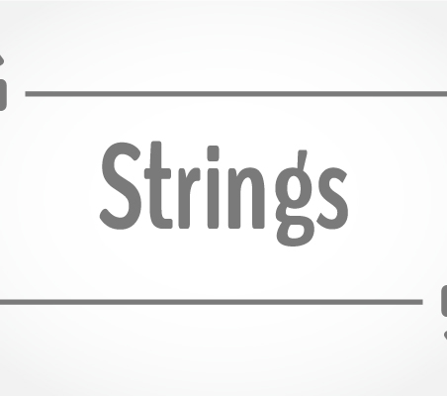
Strings
The text values are called strings
strings values are surrounded by single or double quote so that python recognize which is strings. ‘Hello World’ or “Hello World”
You can even have a strings without character ‘ ‘ this is called blank strings
Supported by
Powered By

Slide 5
Concatenations
>>> ‘alice’ + ‘bob’
>>> ‘alicebob’
>>> ‘Alice’ * 3
>>> AliceAliceAlice
>>> ‘alice’ + 5
>>> Error (can only concatenate str (not "int") to str)
>>> ‘hasib’ * ‘Rabbi’
>>> Error (can't multiply sequence by non-int of type 'str')
You can join two strings but can’t multiply two strings.
Supported by
Powered By

Slide 6
Variable
>>> var_1 = “apple”
>>> var_1
apple
>>>myBalance = 100
>>>yourBalance = 120
>>>myBalance+yourBalance
220
>>>a = “Apple”
>>>b = “Orange”
>>>a+b
AppleOrange
The stuff which may vary.
You don’t have to use quote for integers.
Supported by
Powered By

Slide 7
Variable
>>> var_1 = “apple”
>>> var_1
apple
>>>myBalance = 100
>>>yourBalance = 120
>>>myBalance+yourBalance
220
>>>a = “Apple”
>>>b = “Orange”
>>>a+b
AppleOrange
The stuff which may vary.
You don’t have to use quote for integers.
Supported by
Powered By

Slide 8
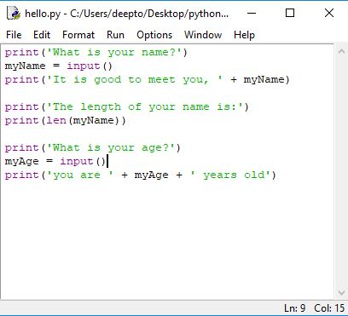
Writing Program in Text Editor
Text editor is used for writing large code or real life project building. Print ( ) function is used to run your code
Supported by
Powered By

Slide 9

Thank You!
You’ll learn flow control from next lab

